Slide 1
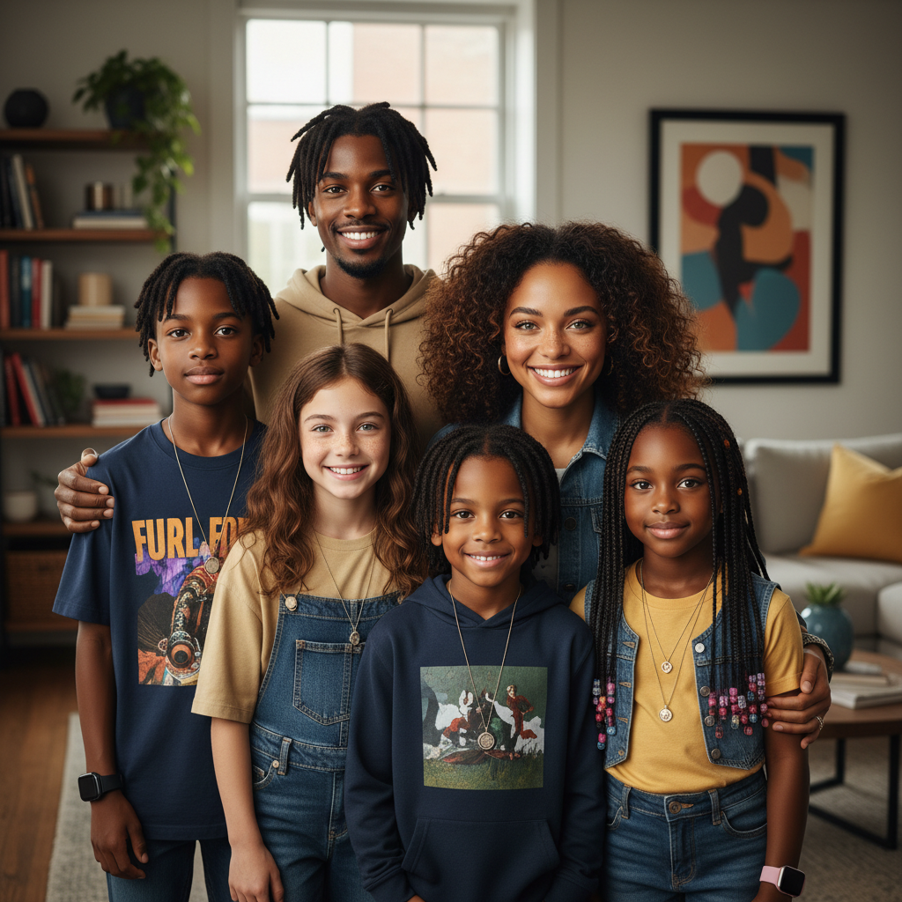
ModelIt!
Student Lesson
Why Do You Look Like That?
The Genetic Lottery That Made You, You
NGSS: MS-LS3-1, MS-LS3-2
8th Grade
1/9

Slide 2
What You Will Learn Today
Learning Goals
* Explain how genes are passed from parents to offspring through chromosomes
* Model how sexual reproduction creates unique genetic combinations
* Predict trait inheritance patterns using dominant and recessive alleles
* Evaluate why genetic variation is important for species survival
Key Vocabulary
Allele
Different versions of the same gene — you inherit one from each parent
Dominant
An allele that is expressed even when only one copy is present
Recessive
An allele that is only expressed when two copies are present
Genotype vs. Phenotype
Genotype is the genetic code (Bb); phenotype is the observable trait (brown eyes)
2/9

Slide 3

The Big Question
Why do you look similar to your parents but not exactly like them?
The Genetic Lottery That Made You, You. Today we'll build a MODEL to discover the answer!
3/9

Slide 4
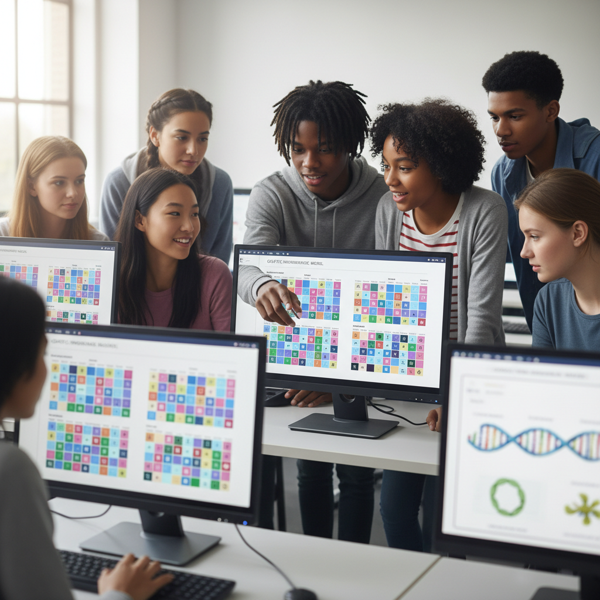
Today We Will Build a Model!
A model helps us understand complex systems!
1. LOCATE
Identify the COMPONENTS (parts) of the system
2. ESTABLISH
Connect them with RELATIONSHIPS (+ or -)
3. VISUALIZE
Build your model in ModelIt!
4. EVALUATE
Run SIMULATIONS to test scenarios
5. REVISE
Improve your model based on evidence
4/9

Slide 5

Activity 1: Sort the Components
Sort these components into EXTERNAL (inputs from outside) and INTERNAL (inside the system):
Your Components:
* Parent 1 Alleles
* Parent 2 Alleles
* Offspring Genotype
* Trait Expression (Phenotype)
Think: Which components can we control? Which happen on their own?
5/9

Slide 6
Activity 2: Connect with Arrows
Draw arrows to show HOW components affect each other:
(+) POSITIVE Relationship
When one goes UP, the other goes UP too
(-) NEGATIVE Relationship
When one goes UP, the other goes DOWN
Think About It:
If both parents carry one dominant and one recessive allele for eye color, what combinations could their child inherit?
6/9

Slide 7
Activity 3: Run the Simulation!
Test these scenarios in ModelIt!
Both Dominant
Set both parents to homozygous dominant (BB × BB)
Carrier Parents
Set both parents to heterozygous (Bb × Bb) — the classic cross
One Recessive Parent
Set one parent to bb and one to Bb
Watch the activity graphs change!
[ModelIt Platform Screenshot - Simulation Results Graph]
7/9

Slide 8
What Did We Discover?
Our Model Showed Us:
* You inherit ONE allele from each parent — your unique combination is why you're genetically unique
* Dominant alleles mask recessive ones, but recessive alleles are still passed on (carriers!)
* The classic Bb × Bb cross produces a 3:1 phenotype ratio (75% dominant, 25% recessive)
* Sexual reproduction creates variation through random allele combinations — that's evolution fuel
Answer: You inherit a random combination of alleles from both parents. Because each parent has two alleles for every gene and you only get one from each, the combination creates a unique genetic blueprint that makes you similar to — but different from — both parents!
8/9

Slide 9
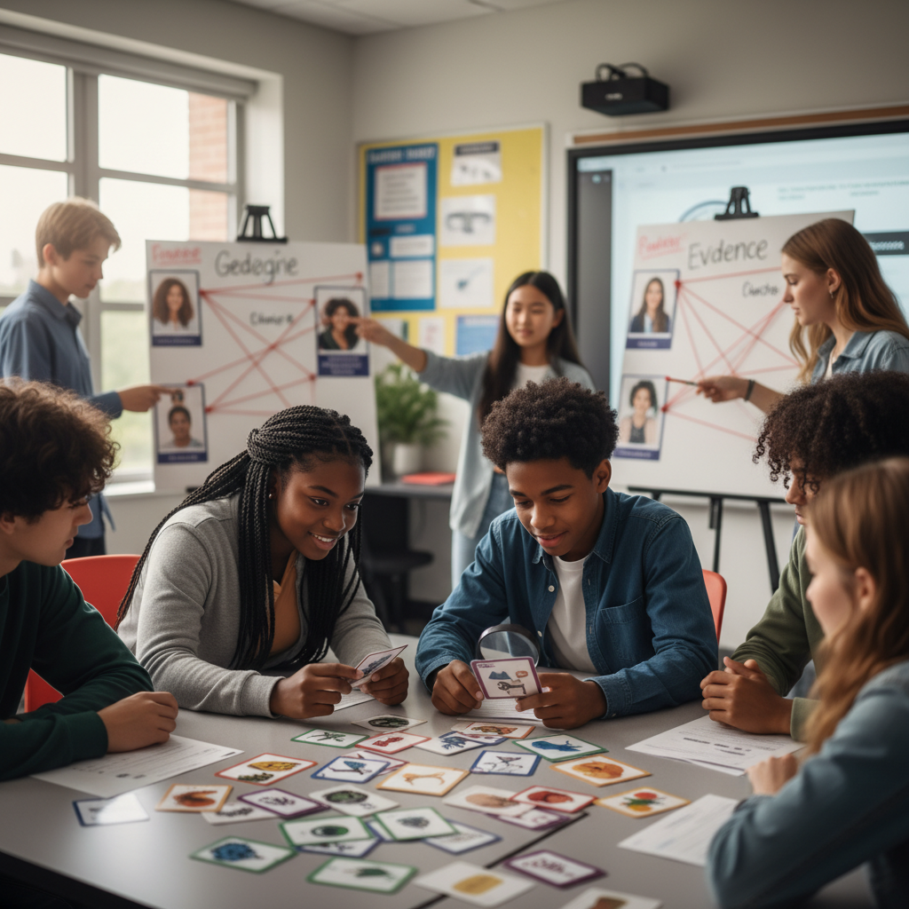
STEM Challenge: Solve a Genetic Mystery
YOUR ENGINEERING MISSION
Use genetic inheritance patterns to solve a real-world mystery: determine the parents of an unknown organism based on trait evidence.
The Challenge:
A wildlife conservation team found a rare animal cub. They need to determine which adults are the parents to manage the breeding program. You have trait data for the cub and several potential parents.
Think Like an Engineer:
* What traits does the cub express? What are its possible genotypes?
* Which parent combinations could produce this phenotype?
* How can you rule out impossible parent combinations?
REAL CAREER CONNECTION: Genetic Counselors help families understand inherited conditions and make informed decisions. Forensic Geneticists use DNA to solve crimes. They earn $65,000-$110,000/year. The skills you're using TODAY are the same ones they use on the job!
9/9

